Slide 1
CIS 4930/6930-002 Data Visualization
Introduction to Visualization
Paul Rosen
Assistant Professor
University of South Florida
(slides adapted from Miriah Meyer)

Slide 2
Why Study Visualization?

Slide 3




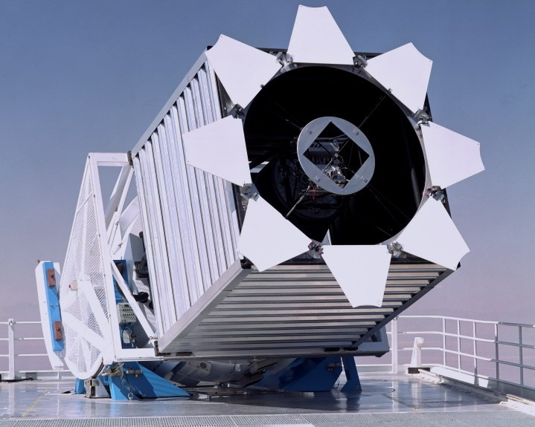
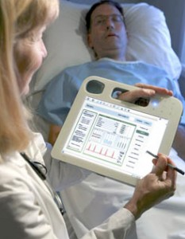










d
ta
data
INDUSTRIAL REVOLUTION OF DATA
Joe Hellerstein, UC Berkley, 2008

Slide 4
HOW MUCH DATA IS THERE?
2010: 1.2 zettabytes
2013: 4.4 zettabytes
2020: ~40 zettabytes
2.5 quintillion bytes / day (2.5 EB)
zettabyte ~= 1,000,000,000,000,000,000,000 or 10²¹
(200x all words ever spoken by humans)

Slide 5
The ability to take data—to be able to understand it, to process it, to extract value from it, to visualize it, to communicate it—that’s going to be a hugely important skill in the next decades...
Because now we really do have essentially free and ubiquitous data. So the complimentary scarce factor is the ability to understand that data and extract value from it.
Google’s Chief Economist, Hal Varian, 2009
http://flowingdata.com/2009/02/25/googles-chief-economist-hal-varian-on-statistics-and-data/

Slide 6

Big Data: Experts say new forms of information analysis will help people be more nimble and adaptive, but worry over humans' capacity to understand and use these new tools well
Tech experts believe the vast quantities of data that humans and machines will be creating by the year 2020 could enhance productivity, improve organizational transparency, and expand the frontier of the "knowable future." But they worry about "humanity's dashboard" beingin government and corporate hands and they are anxious about people's ability to analyze it wisely.
Janna Quitney Anderson, Elon University
lee Rainie, Pew Research Center's Internet & American Life Project
July 20,2012
http://www.pewinternet.org/wp-content/uploads/sites/9/media/Files/Reports/2012/PIP_Future_of_Internet_2012_Big_Data.pdf

Slide 7

Data Science Top Job in 2017 & 2018 according to Glassdoor.com

Slide 8
Why do we create visualizations?
answer questions
generate hypotheses
make decisions
see data in context
expand memory
support computational analysis
find patterns
tell a story
inspire

Slide 9
VISUALIZATION GOALS
record information
analyze data to support reasoning
confirm hypotheses
communicate ideas to others

Slide 10
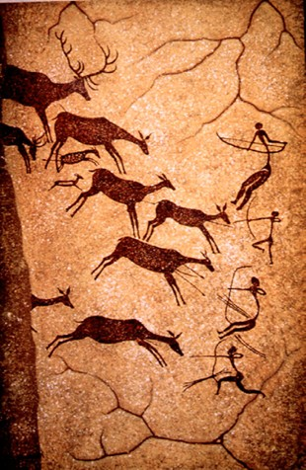

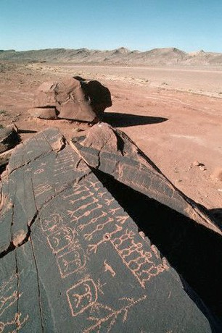

Record Information
http://citrinitas.com/history_of_viscom

Slide 11

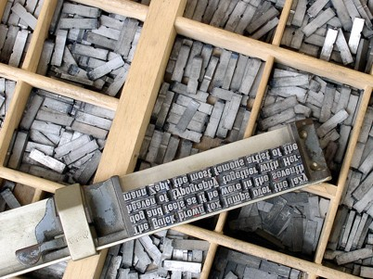

http://citrinitas.com/history_of_viscom

Slide 12
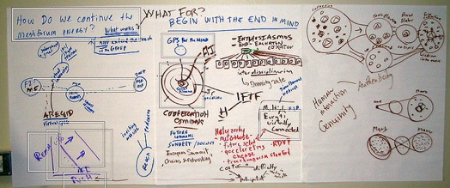

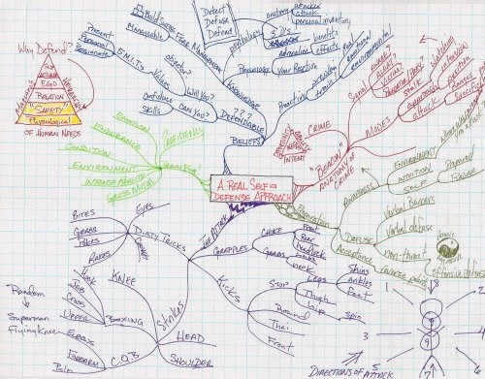
Visual Thinking Collection, Dave Grey

Slide 13
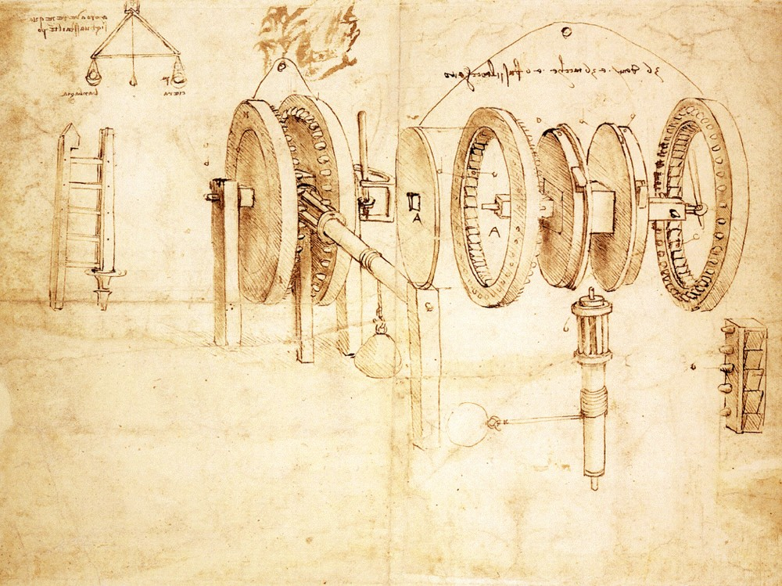
Leonardo da Vinci 1485

Slide 14
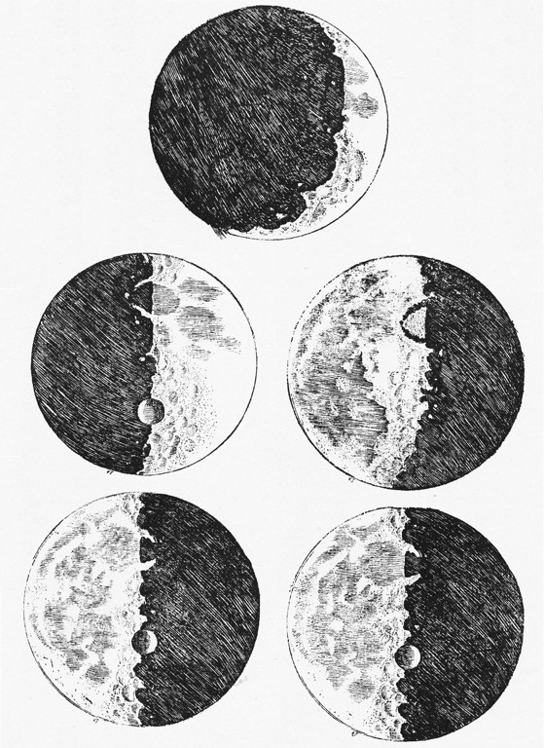
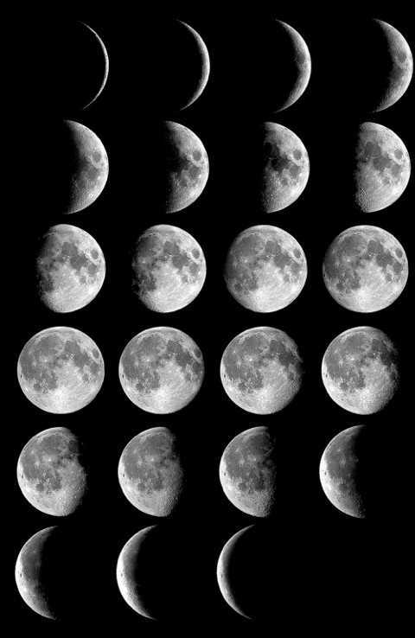
Galileo 1610

Slide 15
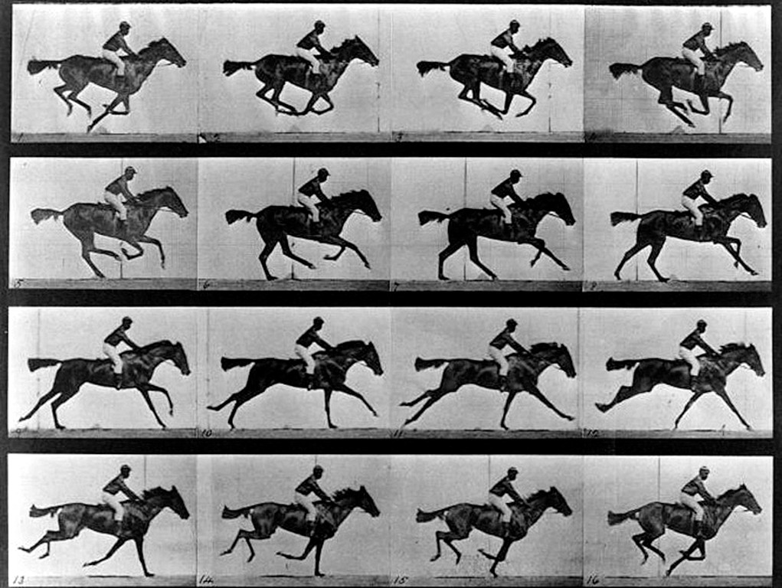
E. J. Muybridge 1878

Slide 16
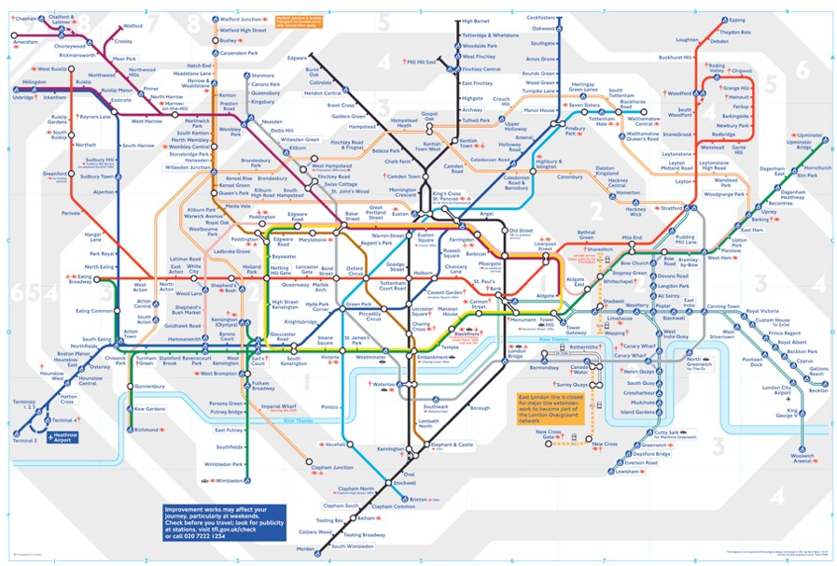
ANALYSIS TO SUPPORT REASONING

Slide 17
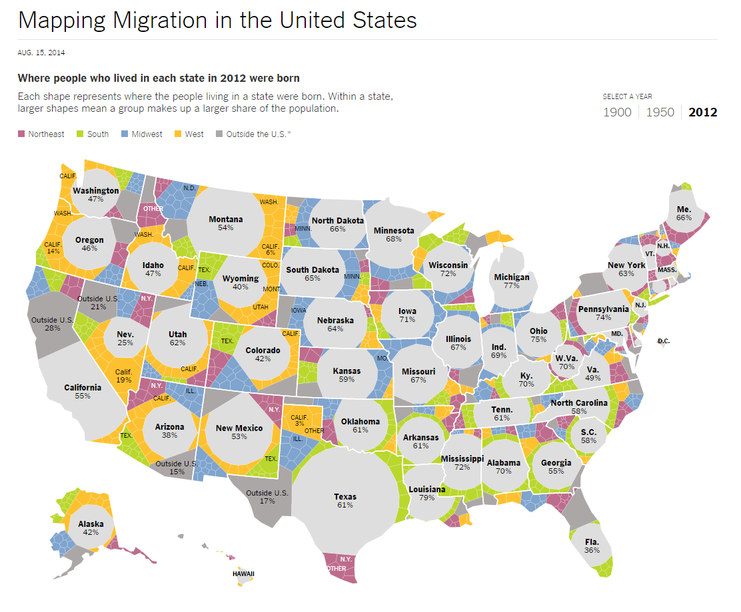
ANALYSIS TO REVEAL PATTERNS
Source: New York Times
http://www.nytimes.com/2014/08/16/upshot/mapping-migration-in-the-united-states-since-1900.html?_r=0

Slide 18
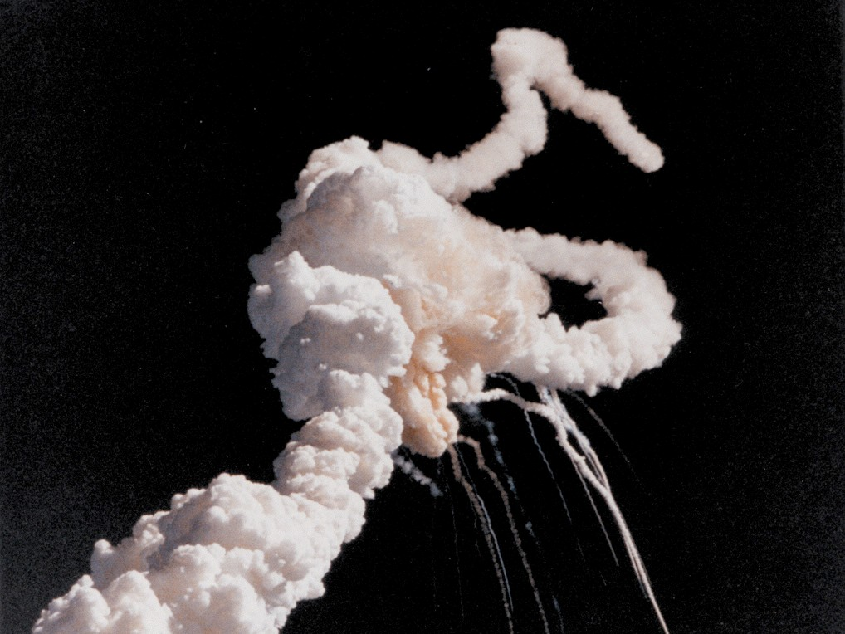
Confirm Hypotheses
THE CHALLENGER DISASTER, 1986
source: Wikipedia

Slide 20
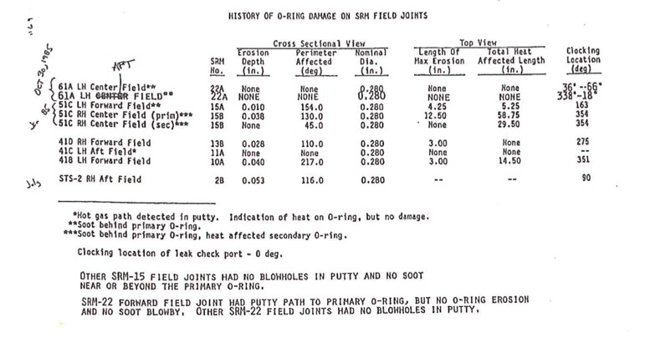
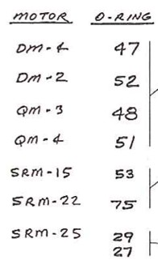
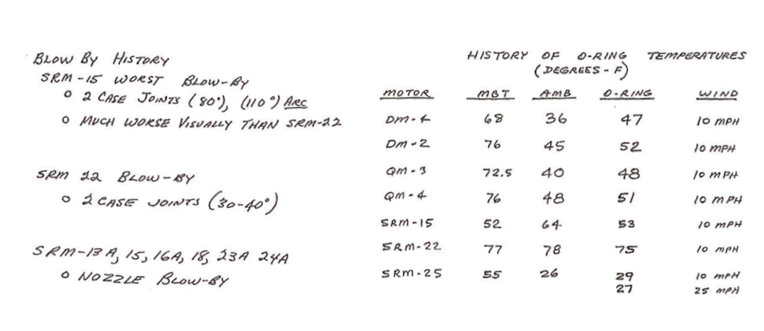
source: E. Tufte

Slide 21
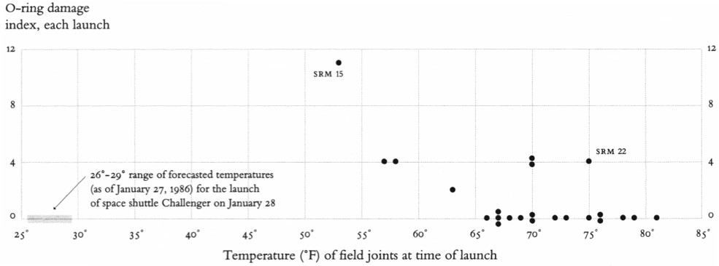
source: E. Tufte

Slide 22
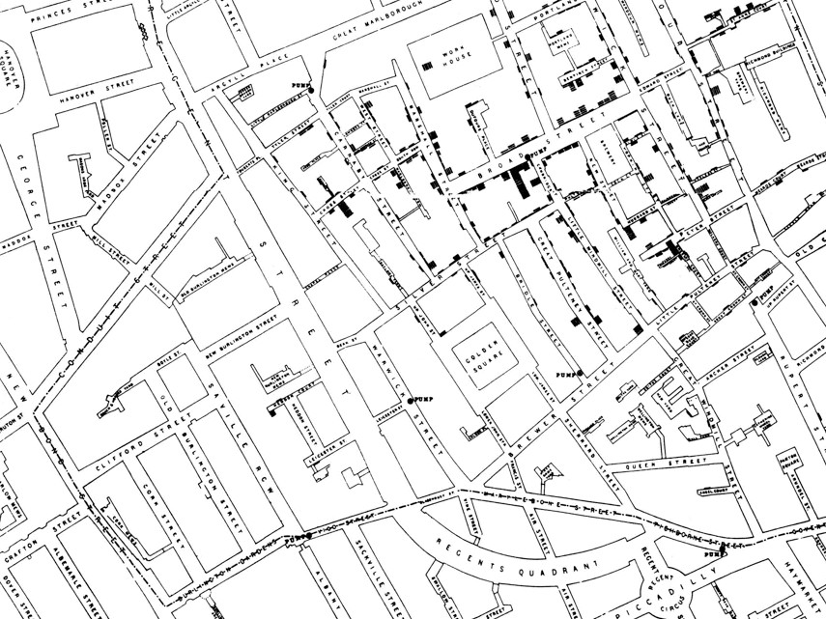

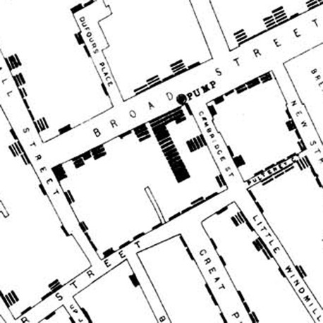
CONFIRM HYPOTHESES
London Cholera Outbreak
John Snow 1854

Slide 23
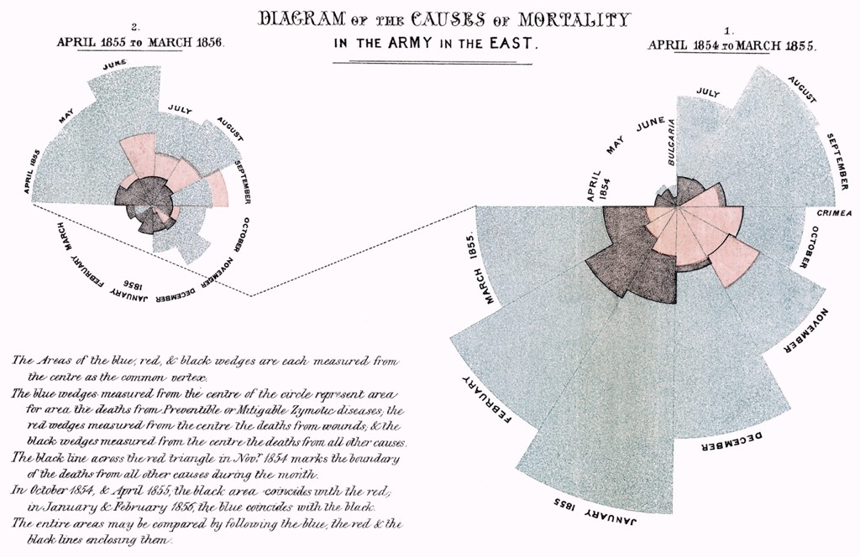
COMMUNICATE IDEAS
Florence Nightingale 1856

Slide 24

Joseph Minard 1861

Slide 25
why does visualization work?
13

Slide 26
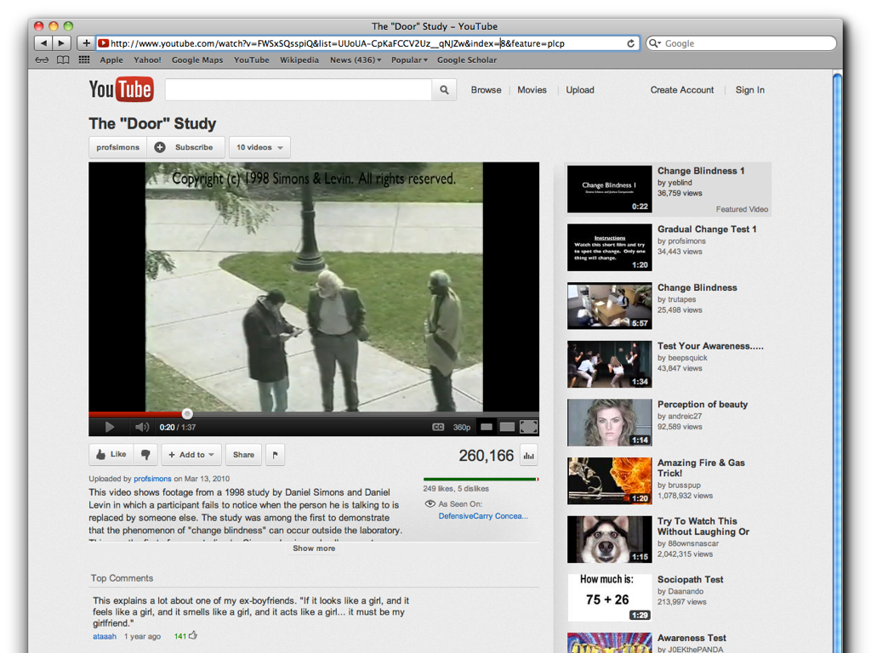
why does visualization work?
cognition is limited

Slide 27
why does visualization work?
cognition is limited
memory is limited

Slide 28
34
calculation exercise . . . x 28
952
Notes:
952

Slide 29
79
calculation exercise . . . x 16
1264
Notes:
1264

Slide 30
34
calculation exercise . . . x 28
Notes:
952

Slide 31
How Visualization works

Slide 32
visualization
uses perception to point out interesting things

Slide 33
MTHIVLWYADCEQGHKILKMTWYN ARDCAIREQGHLVKMFPSTWYARN GFPSVCEILQGKMFPSNDRCEQDI PSGHLMFHKMVPSTWYACEQTWRN

Slide 34
MTHIVLWYADCEQGHKILKMTWYN ARDCAIREQGHLVKMFPSTWYARN GFPSVCEILQGKMFPSNDRCEQDI PSGHLMFHKMVPSTWYACEQTWRN

Slide 35
Visualization
uses pictures to enhance working memory

Slide 36
15 19 60
33 11 75
57 34 79
18 51 92
73 22 13
71 60 22
17 10 68
73 18 55
65 46 29
60 73 22
46 92 97
10 58 46
57 17 83
26 99 33
88 92 60
91 29 57
96 12 47
given these numbers . . .
. . . what number appears most often?

Slide 37
100
given these numbers . . .
. . . what number appears most often?
80
60
40
20
0

Slide 38
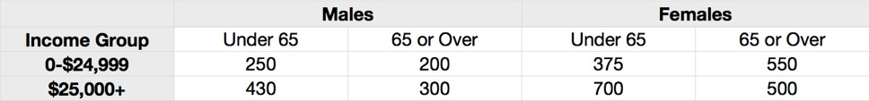
query exercise . . .
QUESTION: Which gender and income level shows a different effect of age on triglyceride levels?
TRIGLYCERIDE LEVEL

Slide 39
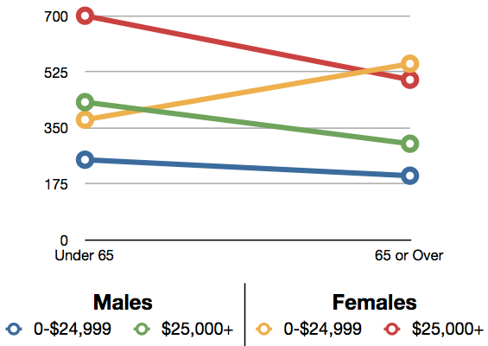
TRIGLYCERIDE LEVEL
QUESTION: Which gender and income level shows a different effect of age on triglyceride levels?

Slide 40
The goal of this course is to introduce students to the principles, methods, and techniques for effective visual analysis of data
We will discuss visualization techniques for a broad range of data types.
You will gain experience using visual analysis tools, as well as in developing your own interactive visualization tools.

Slide 41
FOUNDATIONS
design
perception
data and tasks
visual encoding
interaction
multiple views
filtering and aggregation

Slide 42
TECHNIQUES
tabular data
graphs and trees
text
sets
maps

Slide 43
Advanced Topics
High dimensional data
Vis + Stats
Vis + Machine Learning
Vis + Topology

Slide 44
GROUND RULES
be respectful of everyone’s time
come to class prepared
critique ideas, not people
discuss ideas together, do the assignments on your own
be engaged!

Slide 45
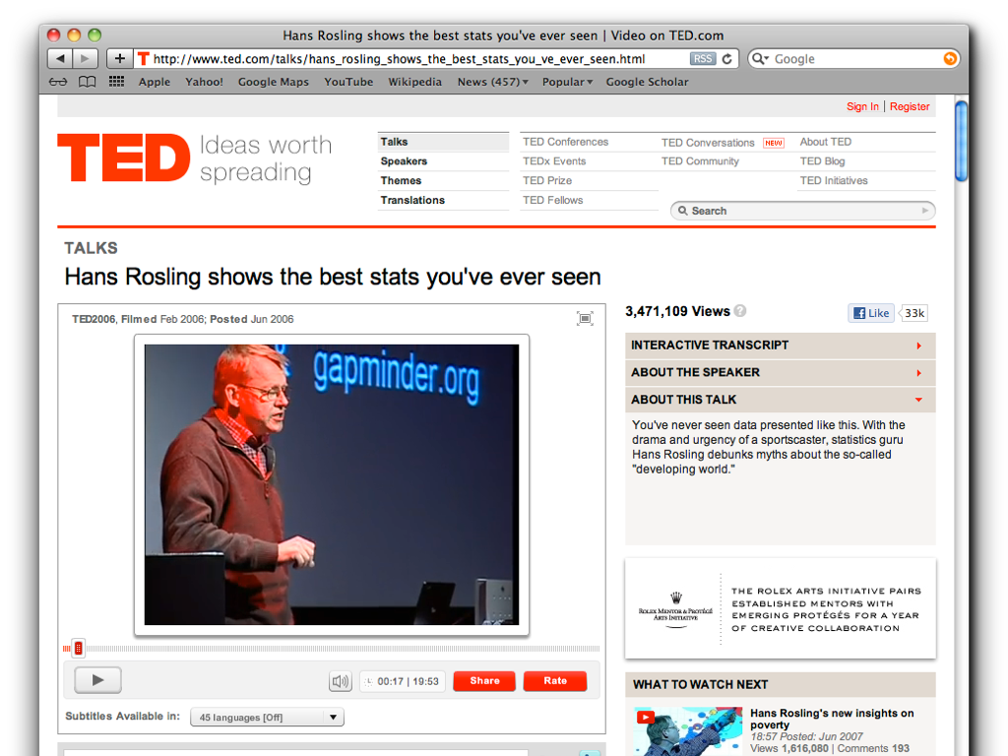
Recommended Watching

Slide 46
Recommended Reading
Visualization Analysis & Design: Chapter 1 (pp. 1-19)

